Slide 1
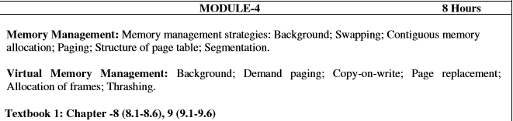
Module 4

Slide 2
Background
Program must be brought (from disk) into memory and placed within a process for it to be run
Main memory and registers are only storage CPU can access directly
Register access in one CPU clock (or less)
Main memory can take many cycles
Cache sits between main memory and CPU registers
Protection of memory required to ensure correct operation

Slide 3
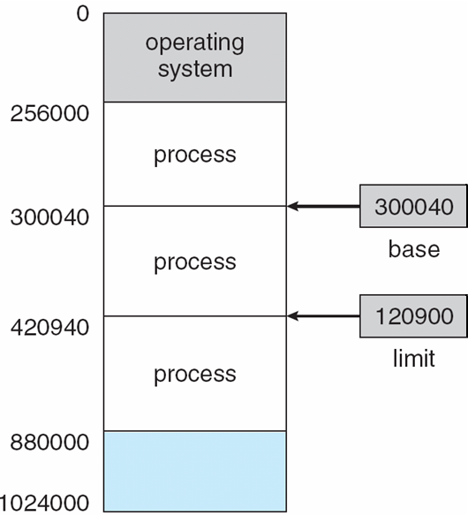
Base and Limit Registers
A pair of base and limit registers define the logical address space

Slide 4
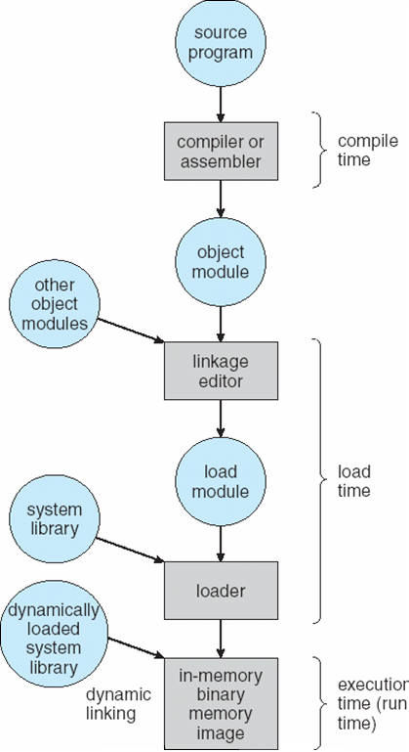
Binding of Instructions and Data to Memory
Address binding of instructions and data to memory addresses can happen at three different stages
  Compile time: If memory location known a priori, absolute code can be generated; must recompile code if starting location changes
  Load time: Must generate relocatable code if memory location is not known at compile time
  Execution time: Binding delayed until run time if the process can be moved during its execution from one memory segment to another. Need hardware support for address maps (e.g., base and limit registers)
Multistep Processing of a User Program

Slide 5
Logical vs. Physical Address Space
The concept of a logical address space that is bound to a separate physical address space is central to proper memory management
  Logical address – generated by the CPU; also referred to as virtual address
  Physical address – address seen by the memory unit
Logical and physical addresses are the same in compile-time and load-time address-binding schemes; logical (virtual) and physical addresses differ in execution-time address-binding scheme

Slide 6
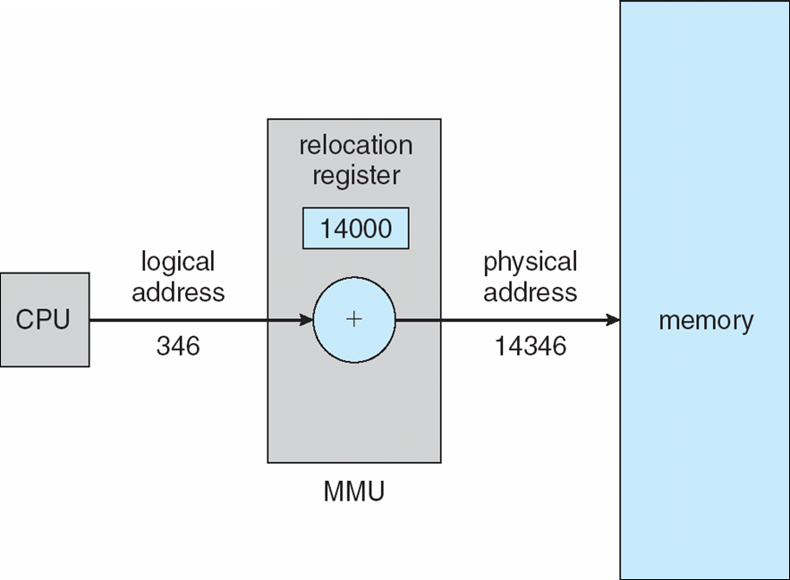
Memory-Management Unit (MMU)
Hardware device that maps virtual to physical address
In MMU scheme, the value in the relocation register is added to every address generated by a user process at the time it is sent to memory
The user program deals with logical addresses; it never sees the real physical addresses
Dynamic relocation using a relocation register

Slide 7
Dynamic Loading
Routine is not loaded until it is called
Better memory-space utilization; unused routine is never loaded
Useful when large amounts of code are needed to handle infrequently occurring cases
No special support from the operating system is required implemented through program design

Slide 8
Dynamic Linking
Linking postponed until execution time
Small piece of code, stub, used to locate the appropriate memory-resident library routine
Stub replaces itself with the address of the routine, and executes the routine
Operating system needed to check if routine is in processes’ memory address
Dynamic linking is particularly useful for libraries
System also known as shared libraries

Slide 9
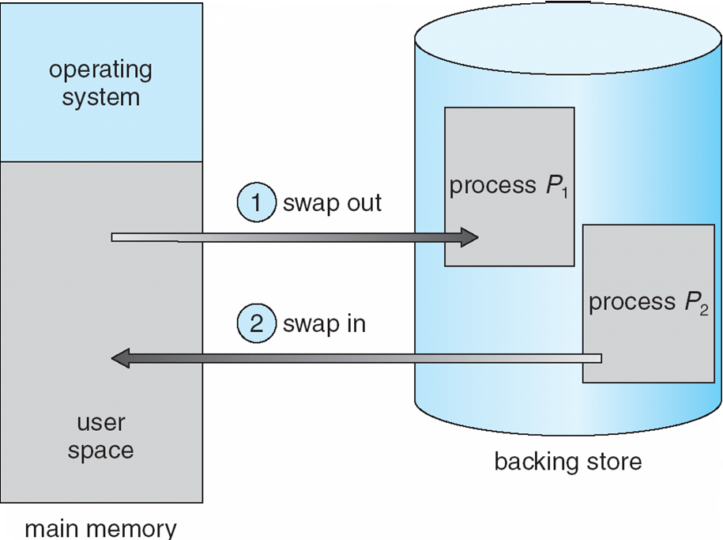
Swapping
A process can be swapped temporarily out of memory to a backing store, and then brought back into memory for continued execution
Backing store – fast disk large enough to accommodate copies of all memory images for all users; must provide direct access to these memory images
Roll out, roll in – swapping variant used for priority-based scheduling algorithms; lower-priority process is swapped out so higher-priority process can be loaded and executed
Major part of swap time is transfer time; total transfer time is directly proportional to the amount of memory swapped
Modified versions of swapping are found on many systems (i.e., UNIX, Linux, and Windows)
System maintains a ready queue of ready-to-run processes which have memory images on disk
Schematic View of Swapping

Slide 10
Contiguous Allocation
Main memory usually into two partitions:
  Resident operating system, usually held in low memory with interrupt vector
  User processes then held in high memory
Relocation registers used to protect user processes from each other, and from changing operating-system code and data
  Base register contains value of smallest physical address
  Limit register contains range of logical addresses – each logical address must be less than the limit register
  MMU maps logical address dynamically

Slide 11

Hardware Support for Relocation and Limit Registers

Slide 12
Contiguous Allocation (Cont)
Multiple-partition allocation
  Hole – block of available memory; holes of various size are scattered throughout memory
  When a process arrives, it is allocated memory from a hole large enough to accommodate it
  Operating system maintains information about:
  a) allocated partitions b) free partitions (hole)
OS
OS
OS
OS
process 5
process 5
process 5
process 5
process 9
process 9
process 8
process 10
process 2
process 2
process 2
process 2

Slide 13
Dynamic Storage-Allocation Problem
How to satisfy a request of size n from a list of free holes
First-fit: Allocate the first hole that is big enough
Best-fit: Allocate the smallest hole that is big enough; must search entire list, unless ordered by size
  Produces the smallest leftover hole
Worst-fit: Allocate the largest hole; must also search entire list
  Produces the largest leftover hole
First-fit and best-fit better than worst-fit in terms of speed and storage utilization

Slide 14
Fragmentation
External Fragmentation – total memory space exists to satisfy a request, but it is not contiguous
Internal Fragmentation – allocated memory may be slightly larger than requested memory; this size difference is memory internal to a partition, but not being used
Reduce external fragmentation by compaction
  Shuffle memory contents to place all free memory together in one large block
  Compaction is possible only if relocation is dynamic, and is done at execution time
  I/O problem
    Latch job in memory while it is involved in I/O
    Do I/O only into OS buffers

Slide 15
Paging
Logical address space of a process can be noncontiguous; process is allocated physical memory whenever the latter is available
Divide physical memory into fixed-sized blocks called frames (size is power of 2, between 512 bytes and 8,192 bytes)
Divide logical memory into blocks of same size called pages
Keep track of all free frames
To run a program of size n pages, need to find n free frames and load program
Set up a page table to translate logical to physical addresses
Internal fragmentation

Slide 16
Address Translation Scheme
Address generated by CPU is divided into:
  Page number (p) – used as an index into a page table which contains base address of each page in physical memory
  Page offset (d) – combined with base address to define the physical memory address that is sent to the memory unit
  For given logical address space 2^{m} and page size 2^{n}
page number
page offset
p
d
m - n
n

Slide 17
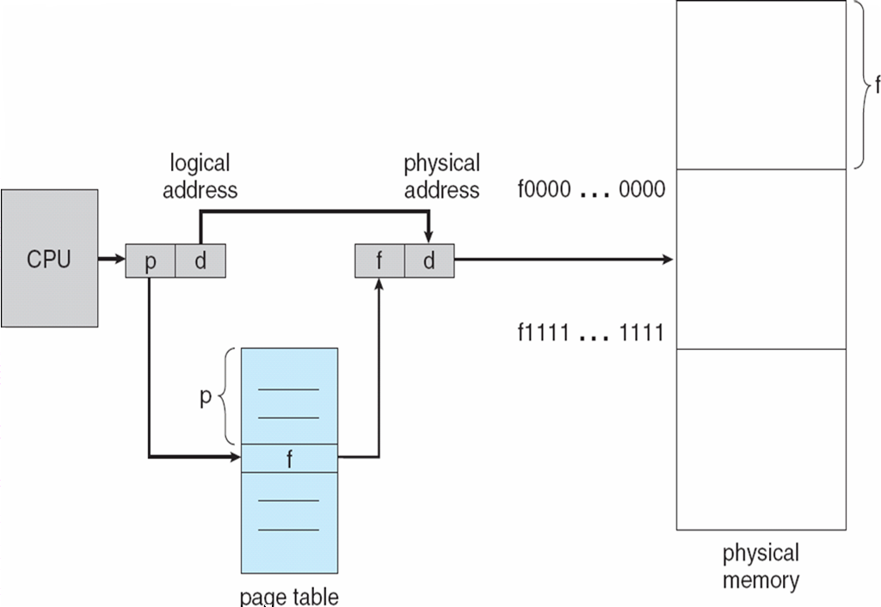
Paging Hardware

Slide 18

Paging Model of Logical and Physical Memory

Slide 19
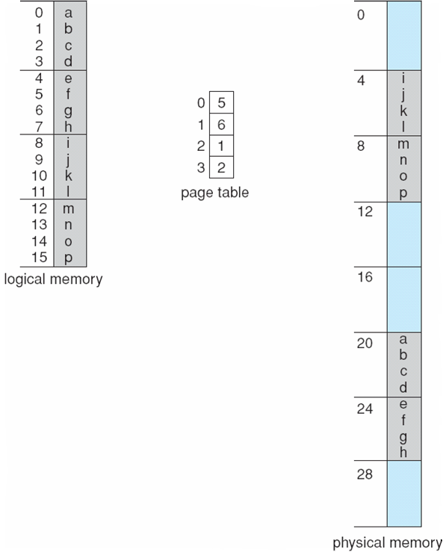
Paging Example
32-byte memory and 4-byte pages

Slide 20

Free Frames
Before allocation
After allocation

Slide 21
Implementation of Page Table
Page table is kept in main memory
Page-table base register (PTBR) points to the page table
Page-table length register (PRLR) indicates size of the page table
In this scheme every data/instruction access requires two memory accesses. One for the page table and one for the data/instruction.
The two memory access problem can be solved by the use of a special fast-lookup hardware cache called associative memory or translation look-aside buffers (TLBs)
Some TLBs store address-space identifiers (ASIDs) in each TLB entry – uniquely identifies each process to provide address-space protection for that process

Slide 22
Associative Memory
Associative memory – parallel search
Address translation (p, d)
  If p is in associative register, get frame # out
  Otherwise get frame # from page table in memory
Page #
Frame #

Slide 23
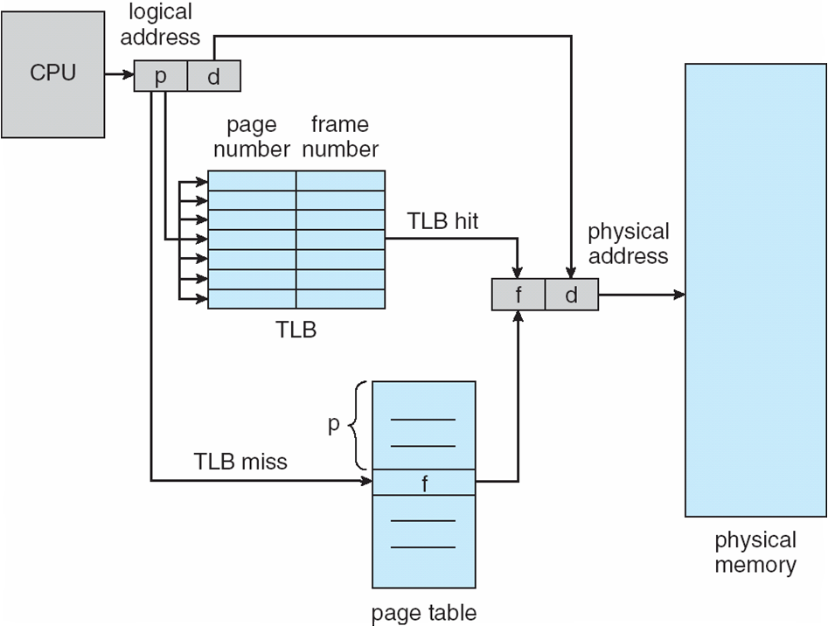
Paging Hardware With TLB

Slide 24
Effective Access Time
Associative Lookup = ε time unit
Assume memory cycle time is 1 microsecond
Hit ratio – percentage of times that a page number is found in the associative registers; ratio related to number of associative registers
Hit ratio = α
Effective Access Time (EAT)
EAT = (1 + ε) α + (2 + ε)(1 – α)
= 2 + ε – α

Slide 25
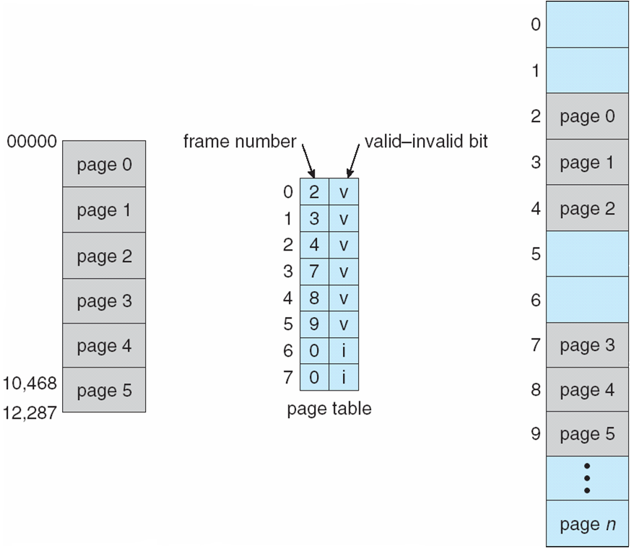
Memory Protection
Memory protection implemented by associating protection bit with each frame
Valid-invalid bit attached to each entry in the page table:
  “valid” indicates that the associated page is in the process’ logical address space, and is thus a legal page
  “invalid” indicates that the page is not in the process’ logical address space
Valid (v) or Invalid (i) Bit In A Page Table

Slide 26
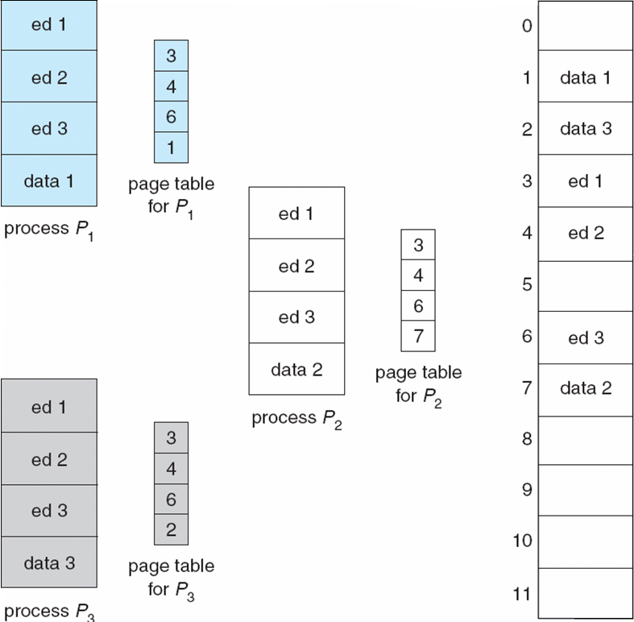
Shared Pages
Shared code
  One copy of read-only (reentrant) code shared among processes (i.e., text editors, compilers, window systems).
  Shared code must appear in same location in the logical address space of all processes
Private code and data
  Each process keeps a separate copy of the code and data
  The pages for the private code and data can appear anywhere in the logical address space
Shared Pages Example

Slide 27
Structure of the Page Table
Hierarchical Paging
Hashed Page Tables
Inverted Page Tables

Slide 28
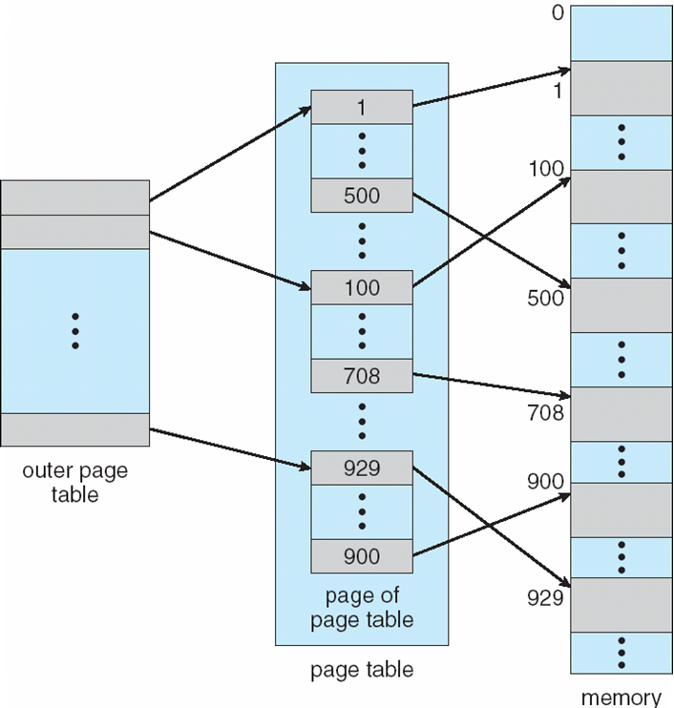
Hierarchical Page Tables
Break up the logical address space into multiple page tables
A simple technique is a two-level page table
Two-Level Page-Table Scheme

Slide 29
Two-Level Paging Example
A logical address (on 32-bit machine with 1K page size) is divided into:
  a page number consisting of 22 bits
  a page offset consisting of 10 bits
Since the page table is paged, the page number is further divided into:
  a 12-bit page number
  a 10-bit page offset
Thus, a logical address is as follows:
where p_{i} is an index into the outer page table, and p₂ is the displacement within the page of the outer page table
page number
page offset
p_{i}
p₂
d
12
10
10

Slide 30
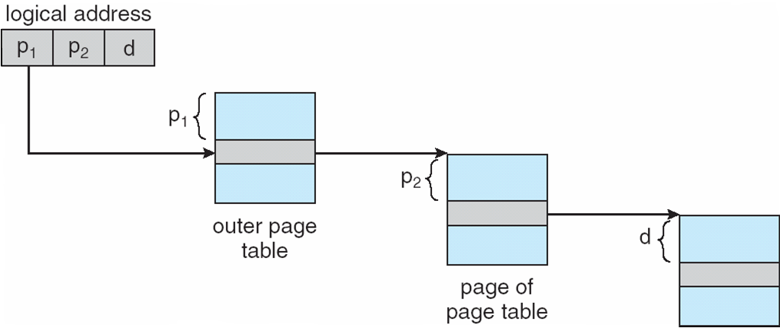
Address-Translation Scheme

Slide 31
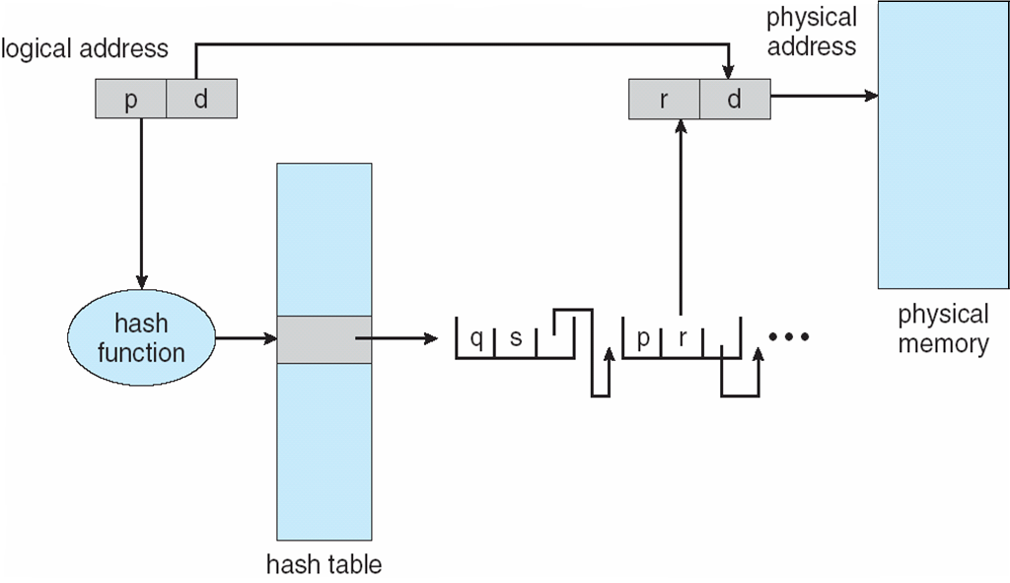
2. Hashed Page Tables
Common in address spaces > 32 bits
The virtual page number is hashed into a page table
  This page table contains a chain of elements hashing to the same location
Virtual page numbers are compared in this chain searching for a match
  If a match is found, the corresponding physical frame is extracted
Hashed Page Table

Slide 32
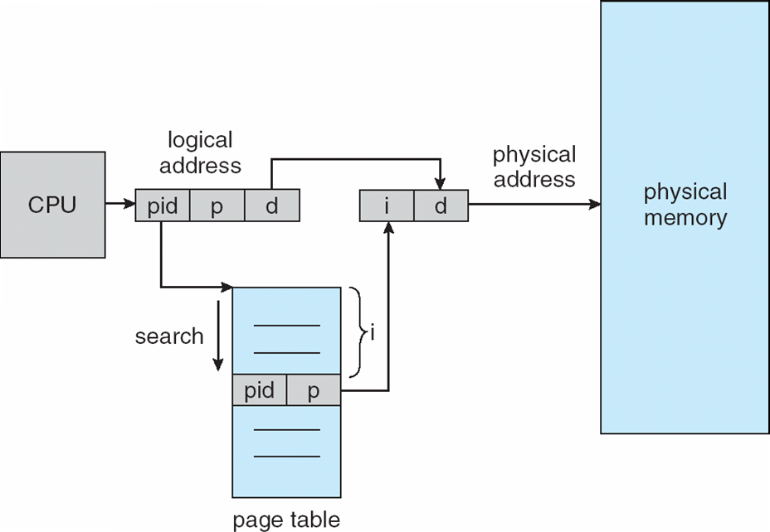
3. Inverted Page Table
One entry for each real page of memory
Entry consists of the virtual address of the page stored in that real memory location, with information about the process that owns that page
Decreases memory needed to store each page table, but increases time needed to search the table when a page reference occurs
Use hash table to limit the search to one — or at most a few — page-table entries
Inverted Page Table Architecture

Slide 33
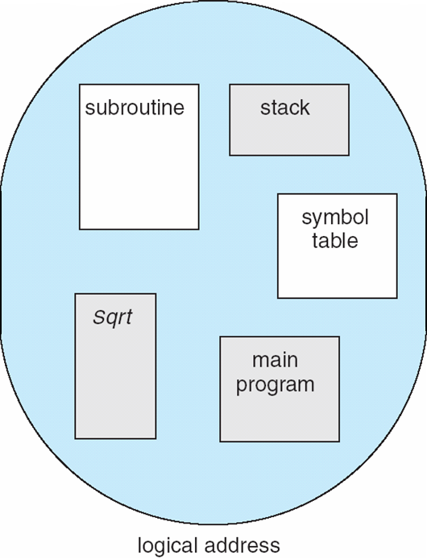
Segmentation
Memory-management scheme that supports user view of memory
A program is a collection of segments
  A segment is a logical unit such as:
main program
procedure
function
method
object
local variables, global variables
common block
stack
symbol table
arrays
User’s View of a Program

Slide 34
Logical View of Segmentation
1
1
4
2
3
4
2
3
user space
physical memory space

Slide 35
Segmentation Architecture
Logical address consists of a two tuple:
<segment-number, offset>,
Segment table – maps two-dimensional physical addresses; each table entry has:
  base – contains the starting physical address where the segments reside in memory
  limit – specifies the length of the segment
Segment-table base register (STBR) points to the segment table’s location in memory
Segment-table length register (STLR) indicates number of segments used by a program;
segment number s is legal if s < STLR
Protection
  With each entry in segment table associate:
    validation bit = 0 ⇒ illegal segment
    read/write/execute privileges
Protection bits associated with segments; code sharing occurs at segment level
Since segments vary in length, memory allocation is a dynamic storage-allocation problem
A segmentation example is shown in the following diagram

Slide 36
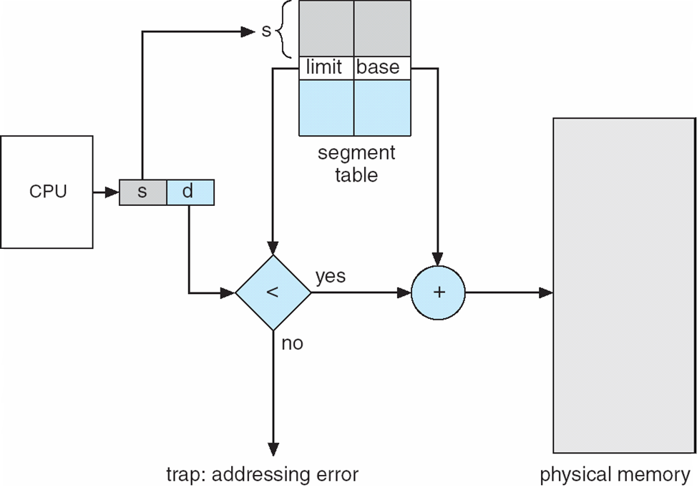
Segmentation Hardware

Slide 37
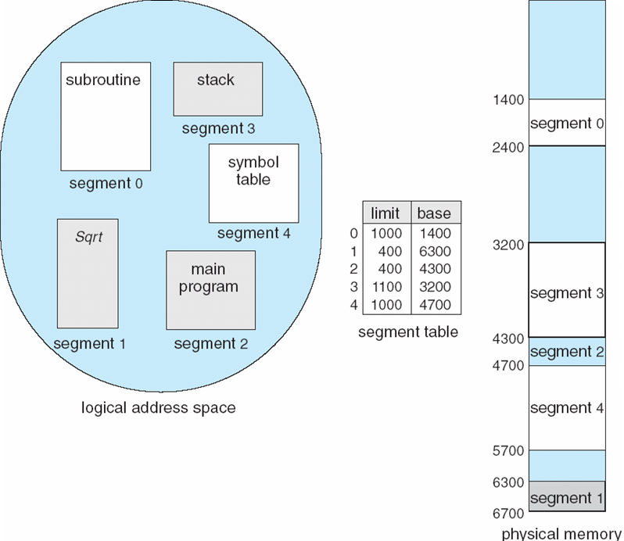
Example of Segmentation

Slide 38
Virtual Memory
Background
Demand Paging
Copy-on-Write
Page Replacement
Allocation of Frames
Thrashing

Slide 39
Background
Virtual memory – separation of user logical memory from physical memory.
  Only part of the program needs to be in memory for execution
  Logical address space can therefore be much larger than physical address space
  Allows address spaces to be shared by several processes
  Allows for more efficient process creation
Virtual memory can be implemented via:
  Demand paging
  Demand segmentation

Slide 40
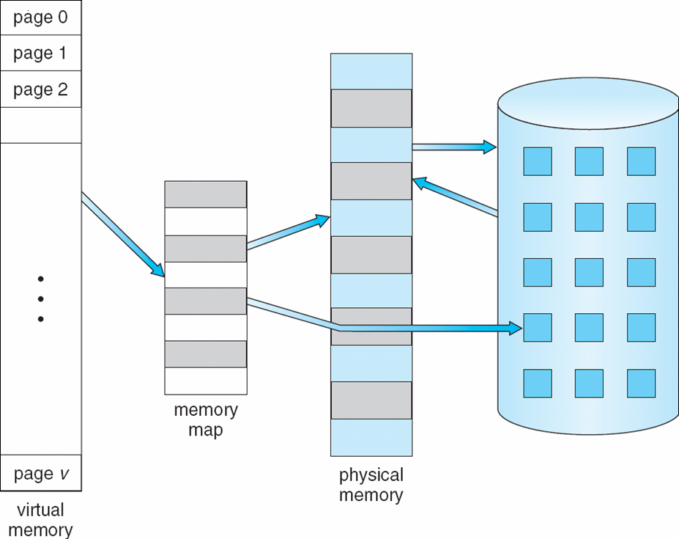
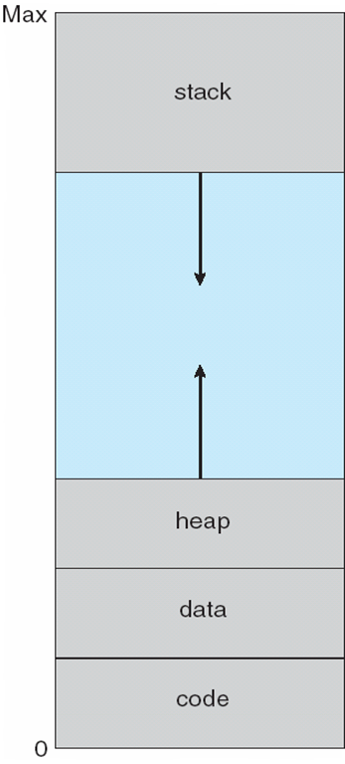
Virtual Memory That is Larger Than Physical Memory
Virtual-address Space

Slide 41
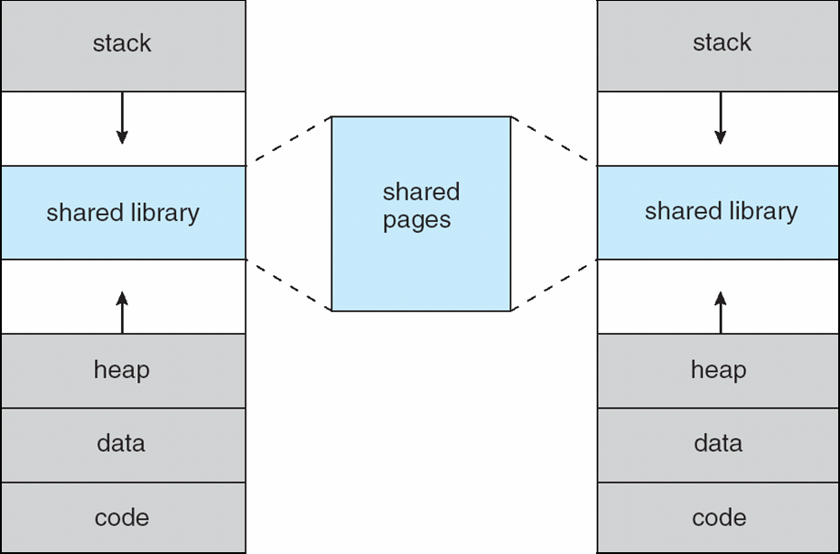
Shared Library Using Virtual Memory

Slide 42
Demand Paging
Bring a page into memory only when it is needed
  Less I/O needed
  Less memory needed
  Faster response
  More users
Page is needed ⇒ reference to it
  invalid reference ⇒ abort
  not-in-memory ⇒ bring to memory
Lazy swapper – never swaps a page into memory unless page will be needed
  Swapper that deals with pages is a pager

Slide 43
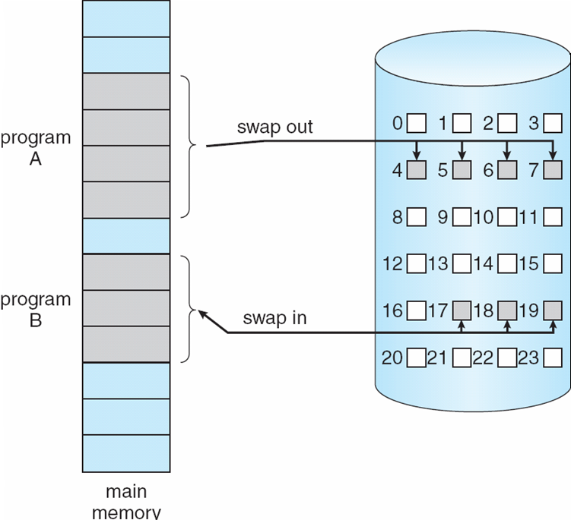
Transfer of a Paged Memory to Contiguous Disk Space

Slide 44
Valid-Invalid Bit
With each page table entry a valid–invalid bit is associated
(v ⇒ in-memory, i ⇒ not-in-memory)
Initially valid–invalid bit is set to i on all entries
Example of a page table snapshot:
During address translation, if valid–invalid bit in page table entry
is I ⇒ page fault
Frame #
valid-invalid bit
v
v
v
v
i
….
i
i
page table

Slide 45
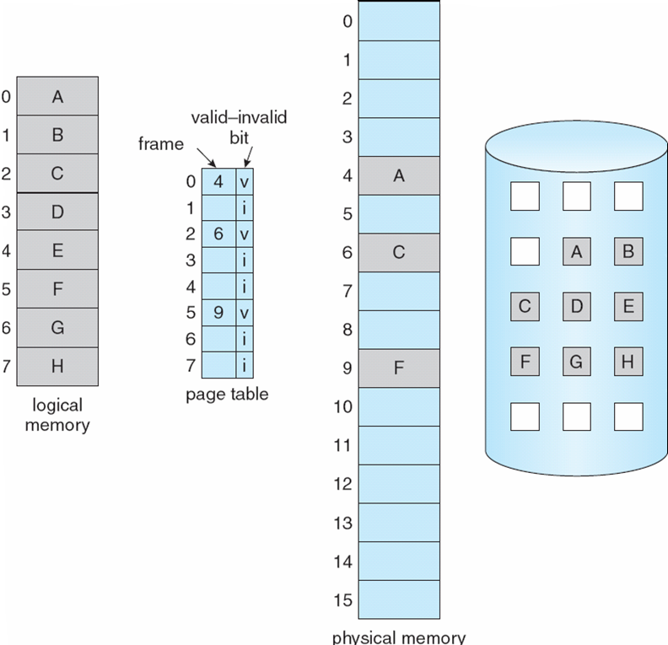
Page Table When Some Pages Are Not in Main Memory

Slide 46
Page Fault
If there is a reference to a page, first reference to that page will trap to operating system:
page fault
Operating system looks at another table to decide:
  Invalid reference ⇒ abort
  Just not in memory
Get empty frame
Swap page into frame
Reset tables
Set validation bit = v
Restart the instruction that caused the page fault
Restart instruction
  block move
  auto increment/decrement location

Slide 47
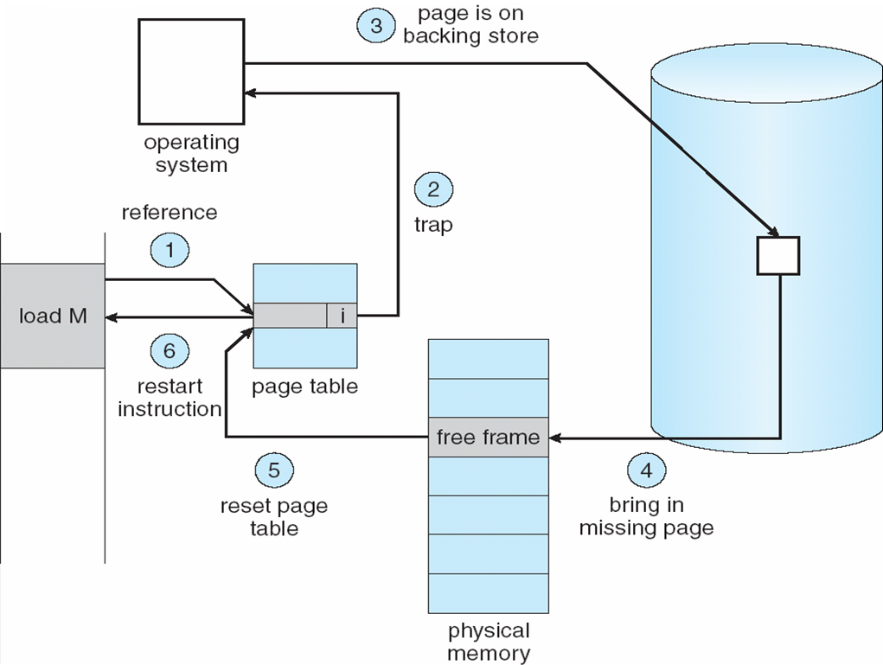
Steps in Handling a Page Fault

Slide 48
Performance of Demand Paging
Page Fault Rate 0 ≤ p ≤ 1.0
  if p = 0 no page faults
  if p = 1, every reference is a fault
Effective Access Time (EAT)
EAT = (1 – p) x memory access
+ p (page fault overhead
+ swap page out
+ swap page in
+ restart overhead
)

Slide 49
Demand Paging Example
Memory access time = 200 nanoseconds
Average page-fault service time = 8 milliseconds
EAT = (1 – p) x 200 + p (8 milliseconds)
= (1 – p x 200 + p x 8,000,000
= 200 + p x 7,999,800
If one access out of 1,000 causes a page fault, then
EAT = 8.2 microseconds.
This is a slowdown by a factor of 40!!

Slide 50
Process Creation
Virtual memory allows other benefits during process creation:
- Copy-on-Write
- Memory-Mapped Files (later)

Slide 51
Copy-on-Write
Copy-on-Write (COW) allows both parent and child processes to initially share the same pages in memory
If either process modifies a shared page, only then is the page copied
COW allows more efficient process creation as only modified pages are copied
Free pages are allocated from a pool of zeroed-out pages

Slide 52
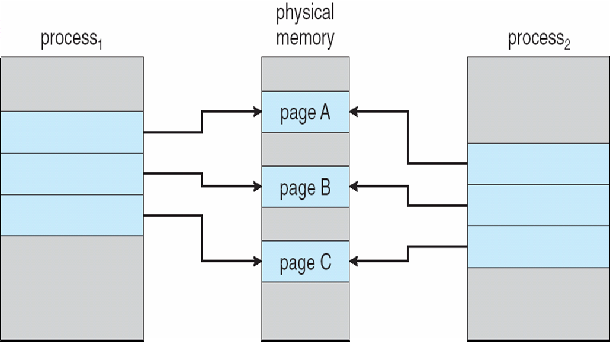
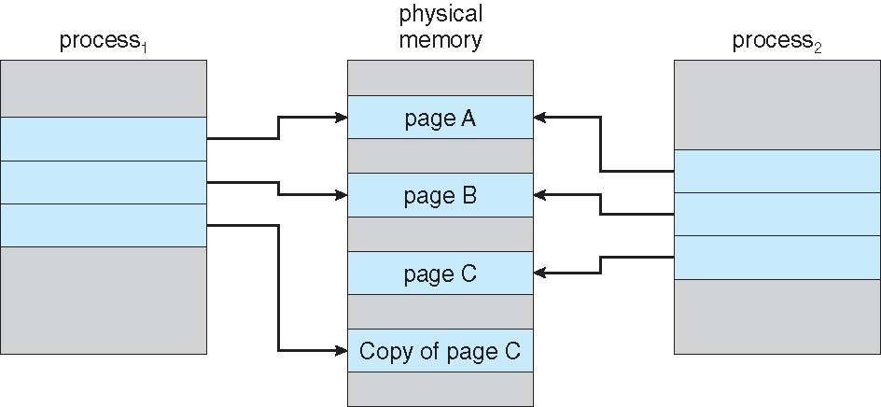
Before Process 1 Modifies Page C
After Process 1 Modifies Page C

Slide 53
What happens if there is no free frame?
Page replacement – find some page in memory, but not really in use, swap it out
  algorithm
  performance – want an algorithm which will result in minimum number of page faults
Same page may be brought into memory several times

Slide 54
Page Replacement
Prevent over-allocation of memory by modifying page-fault service routine to include page replacement
Use modify (dirty) bit to reduce overhead of page transfers – only modified pages are written to disk
Page replacement completes separation between logical memory and physical memory – large virtual memory can be provided on a smaller physical memory

Slide 55
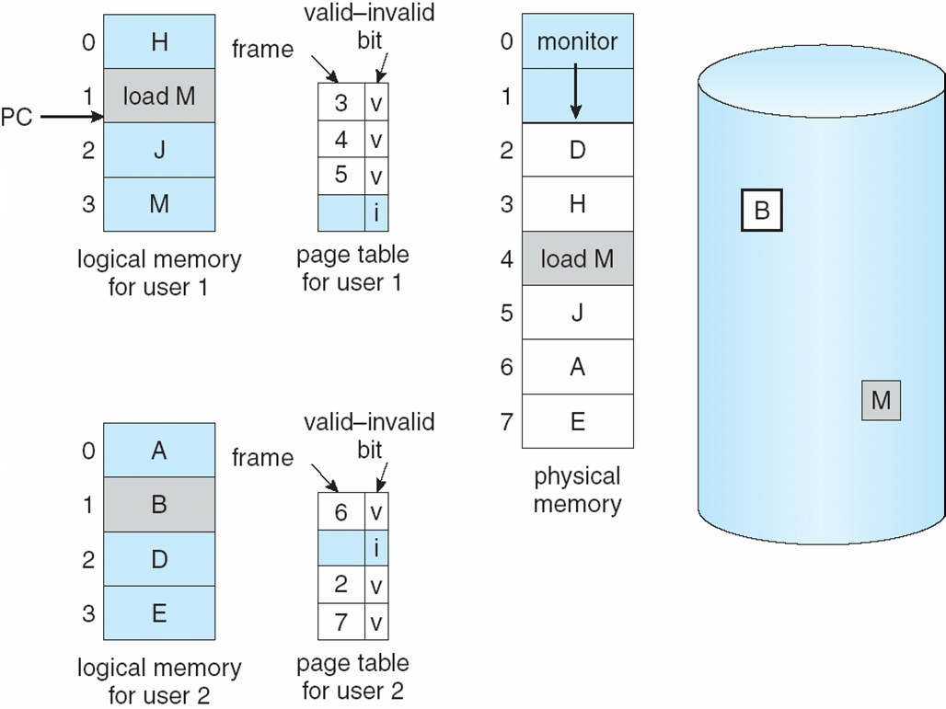
Need For Page Replacement

Slide 56
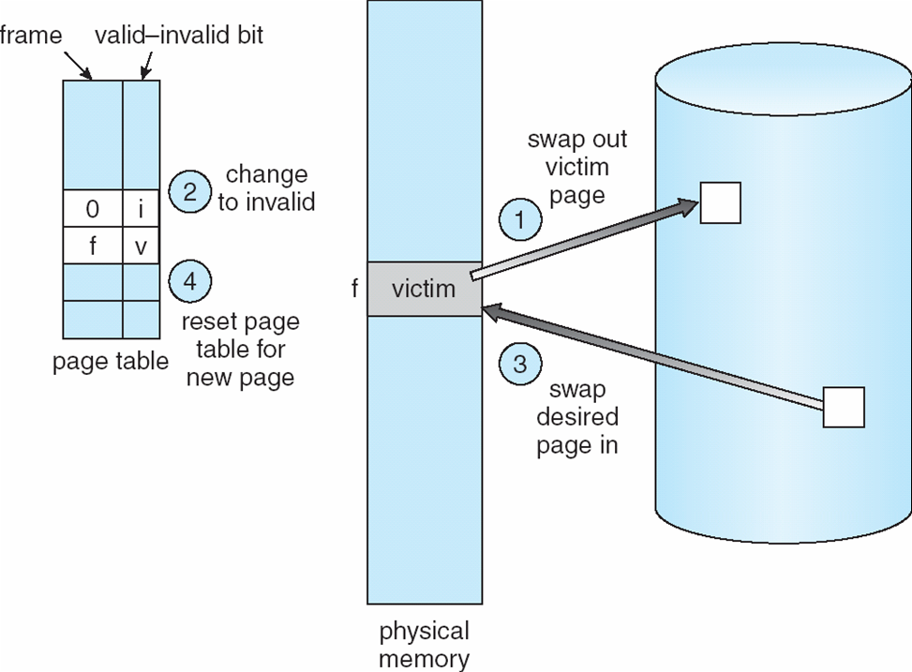
Basic Page Replacement
Find the location of the desired page on disk
Find a free frame:
- If there is a free frame, use it
- If there is no free frame, use a page replacement algorithm to select a victim frame
Bring the desired page into the (newly) free frame; update the page and frame tables
Restart the process
Page Replacement

Slide 57
Page Replacement Algorithms
Want lowest page-fault rate
Evaluate algorithm by running it on a particular string of memory references (reference string) and computing the number of page faults on that string
In all our examples, the reference string is
1, 2, 3, 4, 1, 2, 5, 1, 2, 3, 4, 5

Slide 58
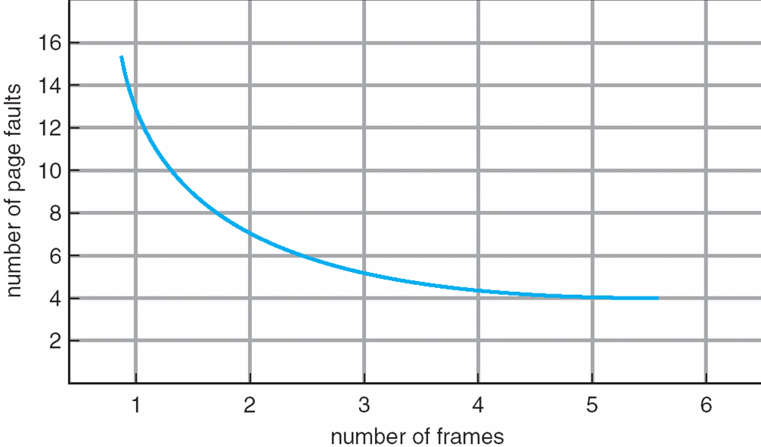
Graph of Page Faults Versus The Number of Frames

Slide 59
First-In-First-Out (FIFO) Algorithm
Reference string: 1, 2, 3, 4, 1, 2, 5, 1, 2, 3, 4, 5
3 frames (3 pages can be in memory at a time per process)
4 frames
Belady’s Anomaly: more frames ⇒ more page faults
1
1
4
5
2
2
1
3
9 page faults
3
3
2
4
1
1
5
4
2
2
1
5
10 page faults
3
3
2
4
4
3

Slide 60
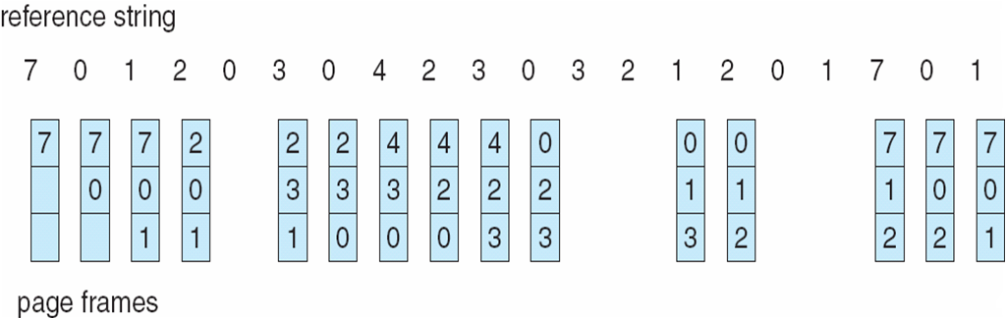
FIFO Page Replacement

Slide 61
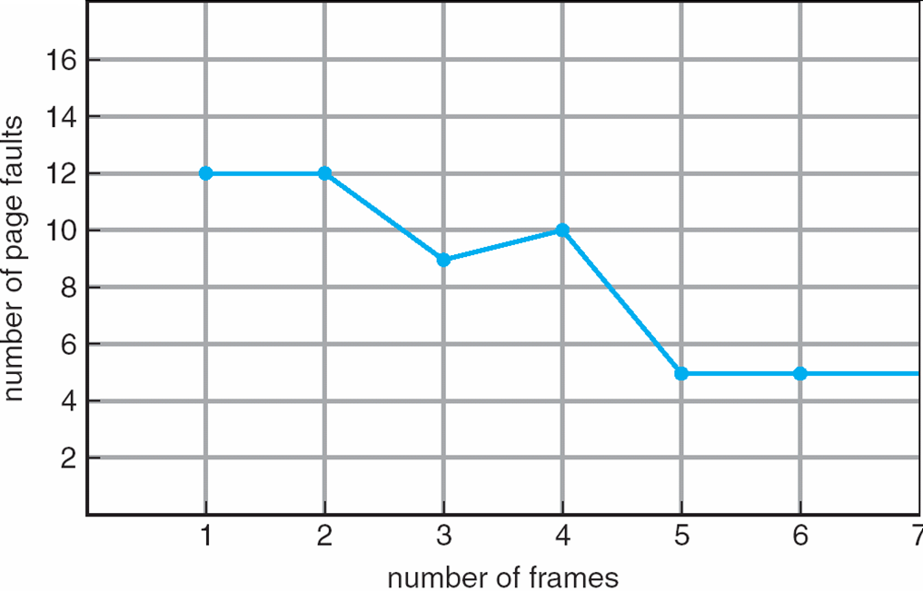
FIFO Illustrating Belady’s Anomaly

Slide 62
Optimal Algorithm
Replace page that will not be used for longest period of time
4 frames example
1, 2, 3, 4, 1, 2, 5, 1, 2, 3, 4, 5
How do you know this?
Used for measuring how well your algorithm performs
1
4
2
3
6 page faults
4
5

Slide 63
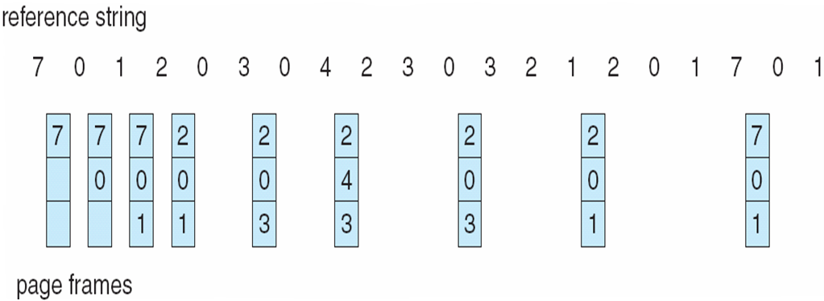
Optimal Page Replacement

Slide 64
Least Recently Used (LRU) Algorithm
Reference string: 1, 2, 3, 4, 1, 2, 5, 1, 2, 3, 4, 5
Counter implementation
  Every page entry has a counter; every time page is referenced through this entry, copy the clock into the counter
  When a page needs to be changed, look at the counters to determine which are to change
1
1
1
1
5
2
2
2
2
2
3
5
5
4
4
4
4
3
3
3

Slide 65
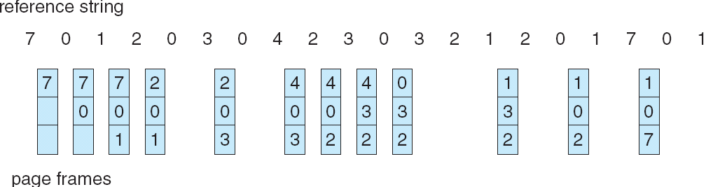
LRU Page Replacement
Stack implementation – keep a stack of page numbers in a double link form:
  Page referenced:
    move it to the top
    requires 6 pointers to be changed
  No search for replacement

Slide 66
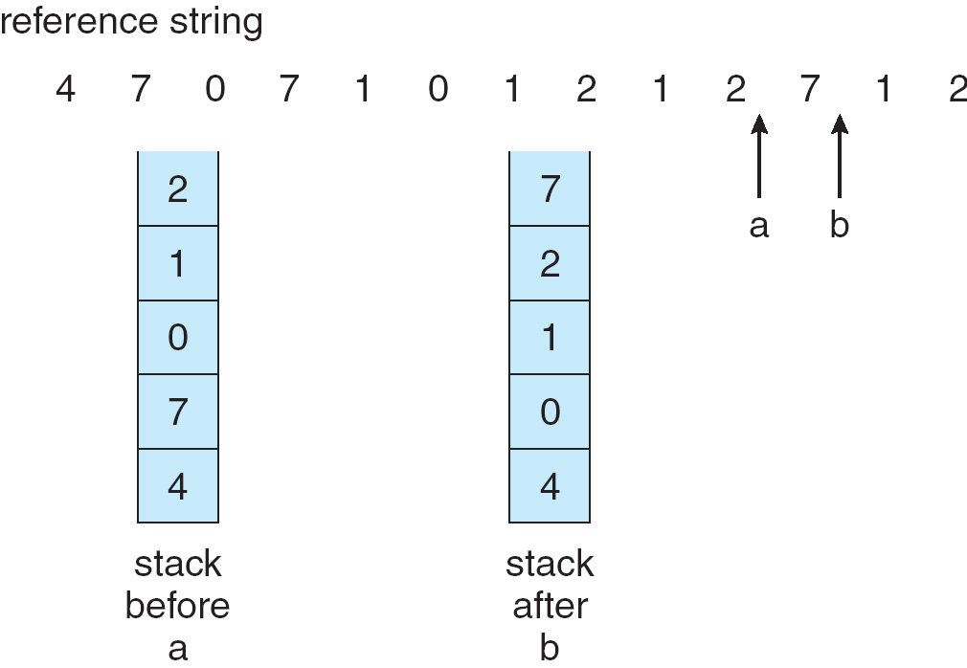
Use Of A Stack to Record The Most Recent Page References

Slide 67
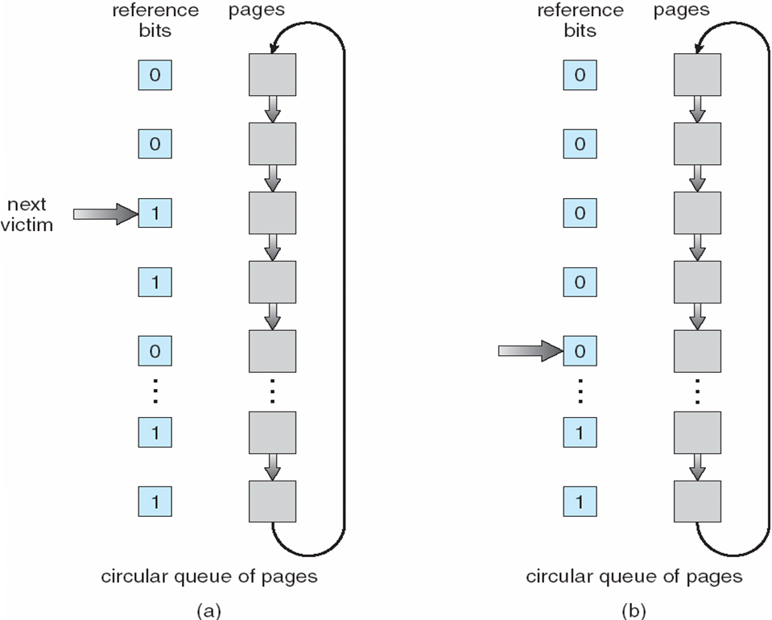
LRU Approximation Algorithms
Reference bit
  With each page associate a bit, initially = 0
  When page is referenced bit set to 1
  Replace the one which is 0 (if one exists)
    We do not know the order, however
Second chance
  Need reference bit
  Clock replacement
  If page to be replaced (in clock order) has reference bit = 1
  then:
    set reference bit 0
    leave page in memory
    replace next page (in clock order), subject to same rules
Second-Chance (clock) Page-Replacement Algorithm

Slide 68
Counting Algorithms
Keep a counter of the number of references that have been made to each page
LFU Algorithm: replaces page with smallest count
MFU Algorithm: based on the argument that the page with the smallest count was probably just brought in and has yet to be used

Slide 69
Allocation of Frames
Each process needs minimum number of pages
Example: IBM 370 – 6 pages to handle SS MOVE instruction:
  instruction is 6 bytes, might span 2 pages
  2 pages to handle from
  2 pages to handle to
Two major allocation schemes
  fixed allocation
  priority allocation

Slide 70
Fixed Allocation
Equal allocation – For example, if there are 100 frames and 5 processes, give each process 20 frames.
Proportional allocation – Allocate according to the size of process

Slide 71
Priority Allocation
Use a proportional allocation scheme using priorities rather than size
If process P_{i} generates a page fault,
  select for replacement one of its frames
  select for replacement a frame from a process with lower priority number
Global vs. Local Allocation
Global replacement – process selects a replacement frame from the set of all frames; one process can take a frame from another
Local replacement – each process selects from only its own set of allocated frames

Slide 72
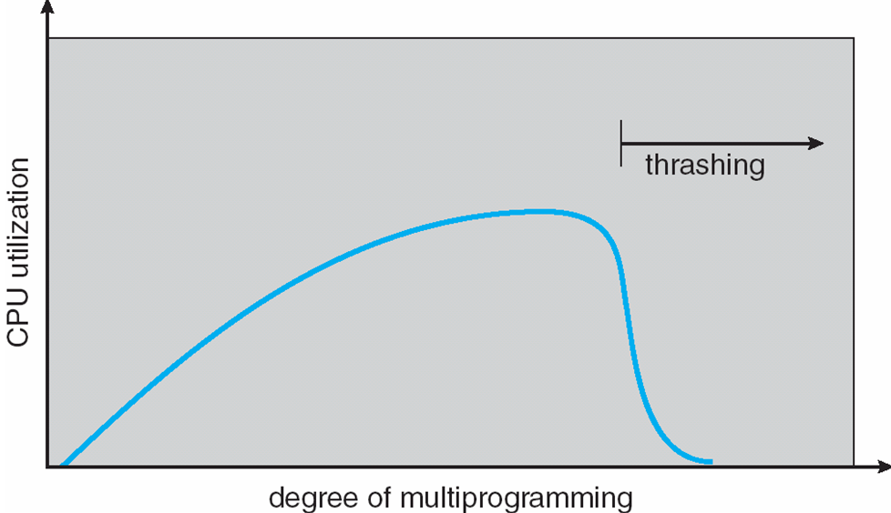
Thrashing
If a process does not have “enough” pages, the page-fault rate is very high. This leads to:
  low CPU utilization
  operating system thinks that it needs to increase the degree of multiprogramming
  another process added to the system
Thrashing ≡ a process is busy swapping pages in and out

Slide 73
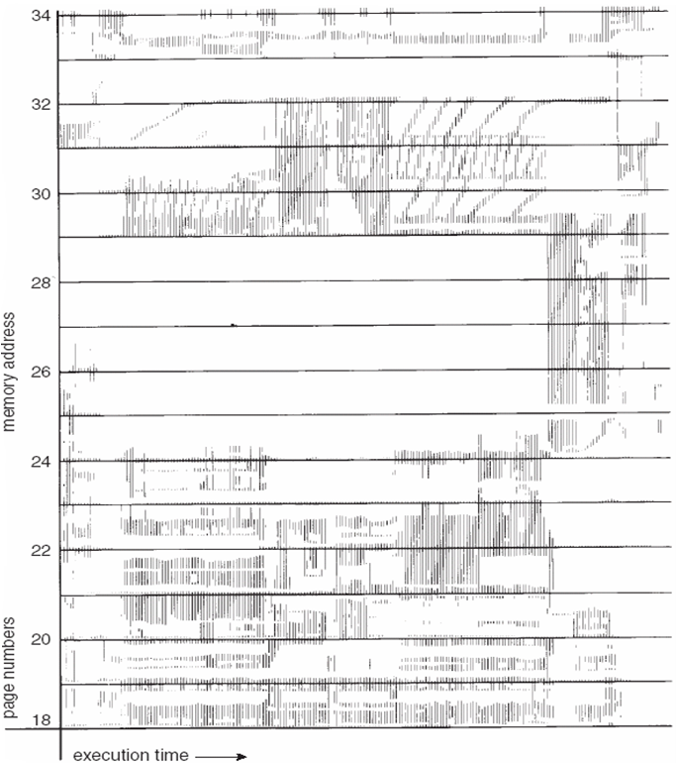
Demand Paging and Thrashing
Why does demand paging work?
Locality model
  Process migrates from one locality to another
  Localities may overlap
Why does thrashing occur?
Σ size of locality > total memory size
Locality In A Memory-Reference Pattern

Slide 74
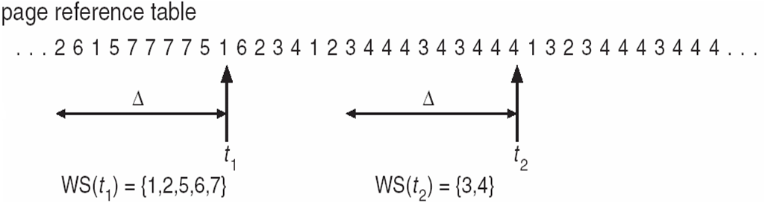
Working-Set Model
Δ ≡ working-set window ≡ a fixed number of page references
Example: 10,000 instruction
WSS_{i} (working set of Process P_{i}) =
total number of pages referenced in the most recent Δ (varies in time)
  if Δ too small will not encompass entire locality
  if Δ too large will encompass several localities
  if Δ = ∞ ⇒ will encompass entire program
D = Σ WSS_{i} ≡ total demand frames
if D > m ⇒ Thrashing
Policy if D > m, then suspend one of the processes

Slide 75
Keeping Track of the Working Set
Approximate with interval timer + a reference bit
Example: Δ = 10,000
  Timer interrupts after every 5000 time units
  Keep in memory 2 bits for each page
  Whenever a timer interrupts copy and sets the values of all reference bits to 0
  If one of the bits in memory = 1 ⇒ page in working set
Why is this not completely accurate?
Improvement = 10 bits and interrupt every 1000 time units

Slide 76
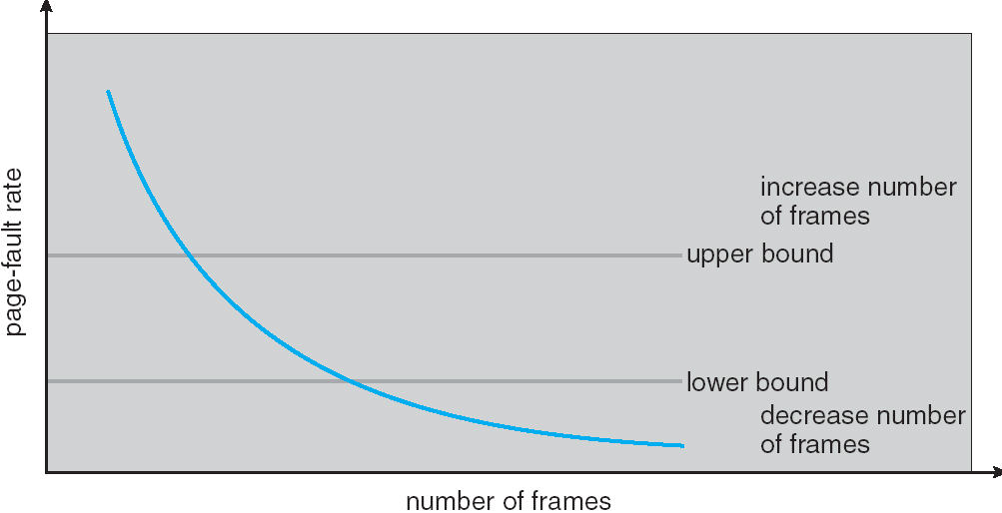
Page-Fault Frequency Scheme
Establish “acceptable” page-fault rate
  If actual rate too low, process loses frame
  If actual rate too high, process gains frame

Slide 77
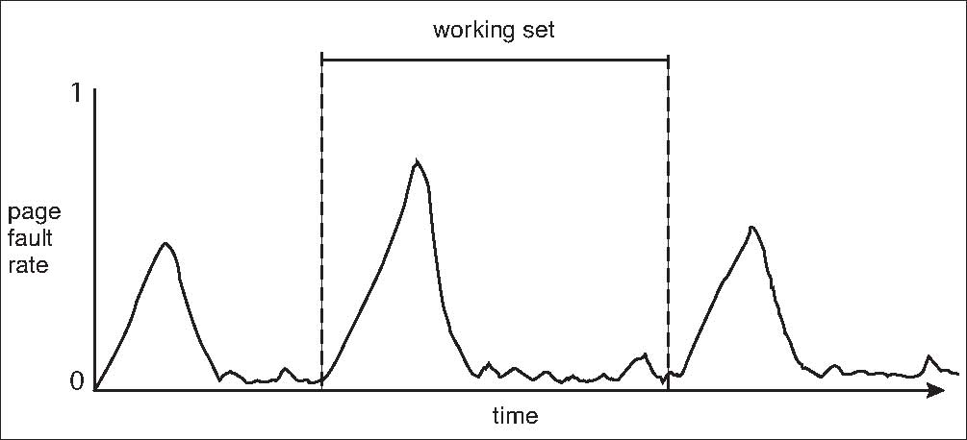
Working Sets and Page Fault Rates

